Slide 1
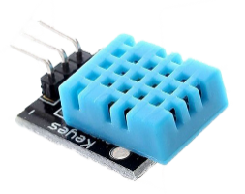
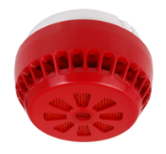




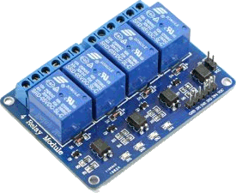
THINGWORX
Temperature & Humidity Sensor
Smoke Sensor
Dashboard
Always ON protocol
Administrator/ Service Personnel
Alerts
Relay

